Slide 1
Stanford ME469: Review of Pressure Projection; Boundary Conditions
Stefan P. Domino
Computational Thermal and Fluid Mechanics
Sandia National Laboratories SAND2018-4536 PE

Slide 2
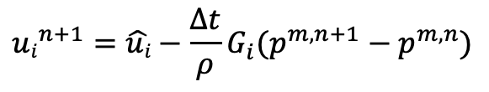


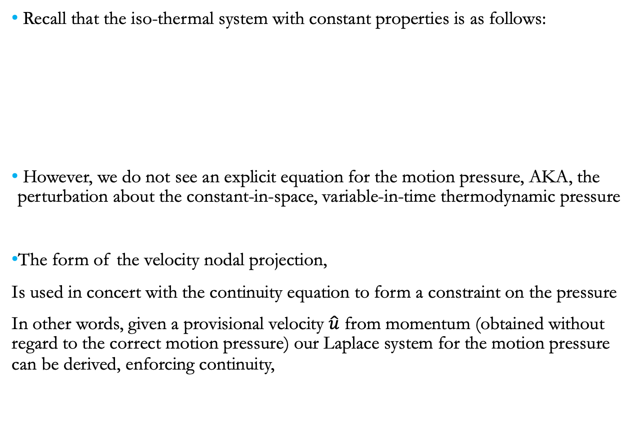
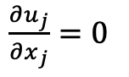
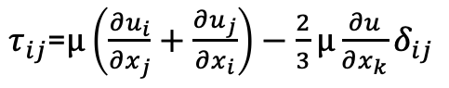
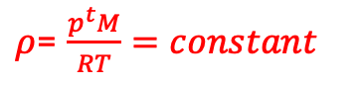
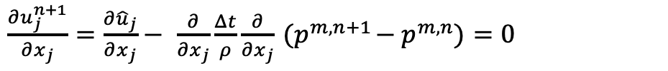
Review on low-Mach and Pressure Projection
Recall that the iso-thermal system with constant properties is as follows:
However, we do not see an explicit equation for the motion pressure, AKA, the perturbation about the constant-in-space, variable-in-time thermodynamic pressure
The form of the velocity nodal projection,
Is used in concert with the continuity equation to form a constraint on the pressure
In other words, given a provisional velocity $\hat{u}$ from momentum (obtained without regard to the correct motion pressure) our Laplace system for the motion pressure can be derived, enforcing continuity,
0.0
Equations:
$\frac{∂u_{j}}{∂x_{j}}$ $=0$
Constitutive:
$τ_{ij}$=$μ\left(\frac{∂u_{i}}{∂x_{j}}+\frac{∂u_{j}}{∂x_{i}}\right)−\frac{2}{3}μ\frac{∂u}{∂x_{k}}δ_{ij}$
$\frac{∂ρu_{i}}{∂t}+\frac{∂ρu_{j}u_{i}}{∂x_{j}}$ - $\frac{∂τ_{ij}}{∂x_{j}}=\frac{−∂p^{m}}{∂x_{i}}$
$$μ=constant$$
Unknowns: u_{i}, p^{m}
Properties:
$ρ$= $\frac{p^{t}M}{RT}=constant$
$${ui}^{n+1}=\hat{ui}−{\frac{Δt}{ρ}G_{i}(p}^{m,n+1}−p^{m,n})$$
$\frac{∂u_{j}^{n+1}}{∂x_{j}}$ $=\frac{∂{\hat{u}}_{j}}{∂x_{j}}−$ $\frac{∂}{∂x_{j}}\frac{Δt}{ρ}\frac{∂}{∂x_{j}}{ (p}^{m,n+1}−p^{m,n})=0$
This is the so-called Pressure Poisson Equation

Slide 3
Incremental Approximate Pressure-Projection with Pressure Stabilization Errors
Let the inverse of A, A⁻¹ be approximated by B₂ as a scalar, τ (which is ~ time scale)
Let B₁ be equal to the scaled Laplace operator, - τL
The new splitting and stabilization error is given by:
The above can be shown to hold a second-order temporal error (coming)
Here, due to equal-order interpolation, i.e., collocation of primitives, L != DG
Therefore, L-DG ~ 4th-order pressure stabilization (pressure oscillations damped)
However, pressure-stabilization error remains
Momentum and Continuity:
$$\left[\begin{matrix}A & 0 \\ D & −τL\end{matrix}\right]\left[\begin{matrix}\hat{u} \\ p^{n+1}\end{matrix}\right]=\left[\begin{matrix}\hat{f} \\ −DτGp^{n}\end{matrix}\right]$$
$$A\hat{u}=f−Gp^{n}$$
$$D\hat{u}=τ(Lp^{n+1}−DGp^{n})$$
Nodal Projection:
$$\left[\begin{matrix}I & τG \\ 0 & I\end{matrix}\right]\left[\begin{matrix}u^{n+1} \\ p^{n+1}\end{matrix}\right]=\left[\begin{matrix}\hat{u} \\ \hat{p}\end{matrix}\right]+\left[\begin{matrix}τGp^{n} \\ 0\end{matrix}\right]$$
$$u^{n+1}=\hat{u}−{τG(p}^{n+1}−p^{n})$$
$$p^{n+1}=\hat{p}$$
Examples:
Rhie-Chow (1983)
Peric (1985)
Domino (2006)
$$\left[\begin{matrix}A & G \\ D & 0\end{matrix}\right]\left[\begin{matrix}u^{n+1} \\ p^{n+1}\end{matrix}\right]=\left[\begin{matrix}f \\ 0\end{matrix}\right]+\left[\begin{matrix}\left(I−Aτ\right)G{(p}^{n+1}−p^{n}) \\ τ\left(L−DG\right)p^{n+1}\end{matrix}\right]$$

Slide 4
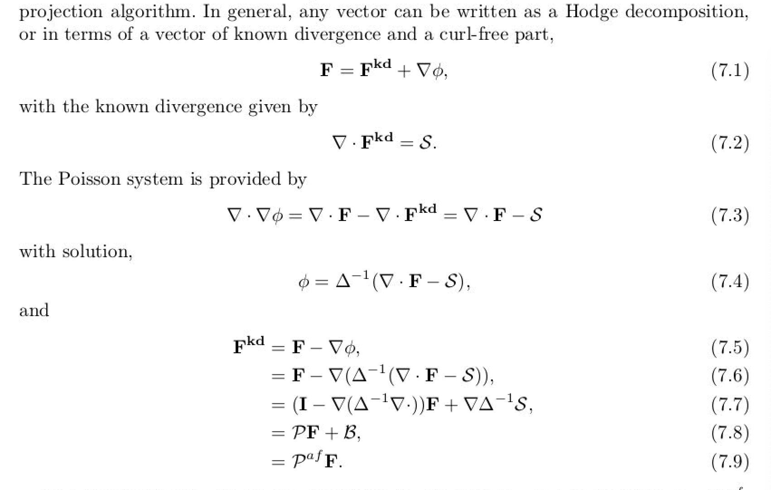
Why ”pressure projection”?
From Domino, 2006 “﻿Toward verification of formal time accuracy for a family of approximate projection methods using the method of manufactured solutions”
For a solenoidal vector, div(u) is zero and P is an “idempotent” projection, i.e., P=P²
Otherwise, P is an affine-projection operator

Slide 5
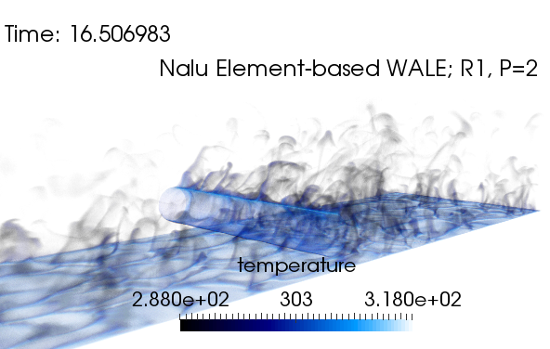
A note on boundary conditions
Typical boundaries include the following (mapping to what we know physically in the system):
Inflow: quantities are known
Wall: velocity, temperature, scalar flux, etc., are known (“no-slip”)
Open: flow leaves or enters the domain with a known “pressure” (static or total); zero gradient
Symmetry: no-penetration, zero tangential viscous condition
Periodic: perfect mapping between nodes at provided surface pairs; provides an infinite domain assumption
Non-conformal: static or dynamic/sliding mesh interface in which the surface pair is non-conformal in nature
Symmetry, “flow slips along” (normal stress pn_{i}dS applied with tangential stress = 0)
Open
(known P and far field temperature)
Inflow
(known T and u_{i})
Span-wise periodic
Neumann for p everywhere other than open; SPL
Wall (known T and u_{i})

Slide 6
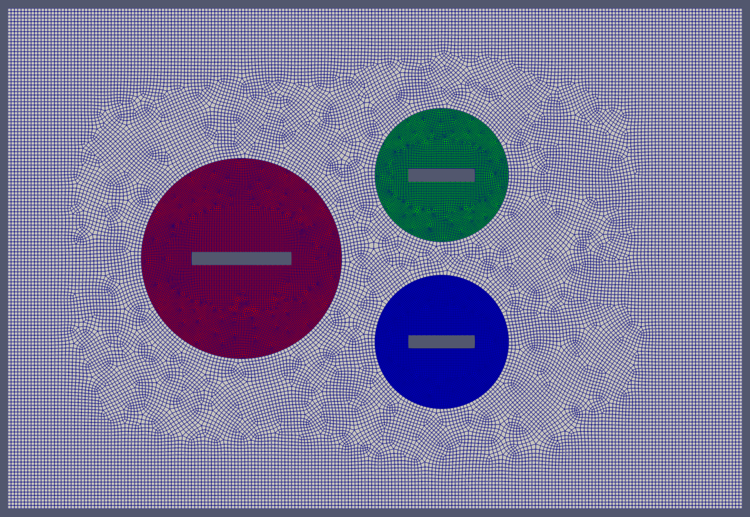
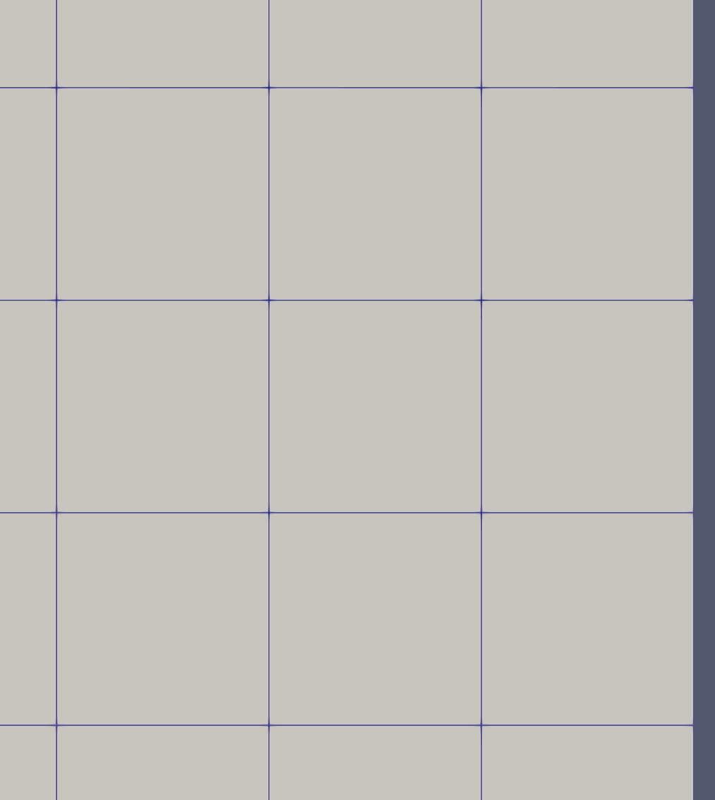
Boundary Condition Locations
Recall, that for a 1) vertex-based discretization scheme, the degree of freedom at boundary faces reside on the boundary allowing for “weak” or “strong”, while 2) cell-centered approaches support “weak”, or “flux-based”

Slide 7
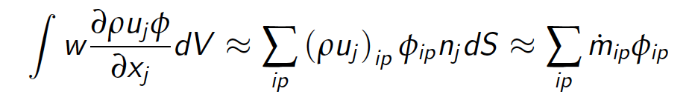
Boundary Condition Locations: Weak, i.e., “Flux” vs “Strong”, i.e., Dirichlet
Recall, that for a 1) vertex-based discretization scheme, the degree of freedom at boundary faces resides on the boundary allowing for “weak” or “strong”, while 2) cell-centered approaches support “weak”, or “flux-based”
Consider an inflow of φ (entering the domain from the right to the left)
Vertex-based can choose weak
or strong. It’s your choice

Slide 8
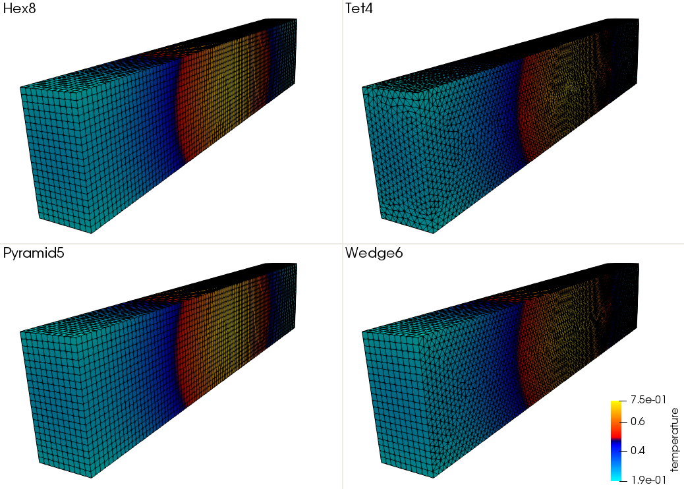
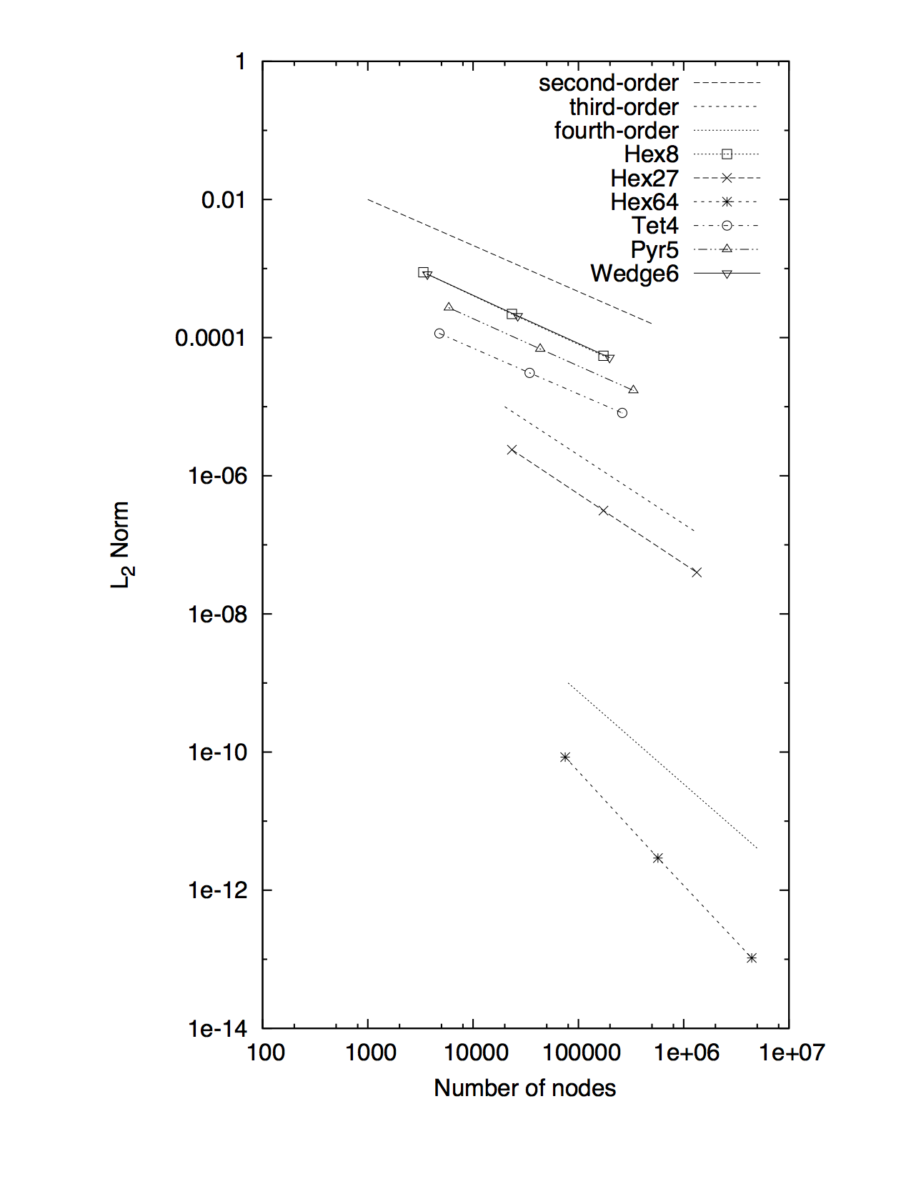

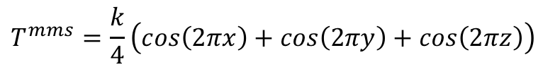
Weak vs Strong Example
$$T^{mms}=\frac{k}{4}\left(cos\left(2πx\right)+cos\left(2πy\right)+cos\left(2πz\right)\right)$$
For vertex-based schemes, the degree-of-freedom “lives” at the boundary
In some cases, e.g., wall, inflow and open, boundary condition can be provided by a Dirichlet bc (AKA, strong implementation of a known field).
A Dirichlet procedure either condenses the row out of the system or zeroes the row with a unity in the diagonal and the specified value on the RHS
Consider a simple heat conduction solution in which temperature is known at the boundaries
It can be shown (see Svard and Nordstrom, JCP, 2008) that a stable and accurate weak BC implementation is provided by:
$$q_{n}=−λ\frac{∂T}{∂x_{j}}n_{j}+γ\frac{λ}{L}\left(T−T^{bc}\right)$$
Here, γ is a constant greater than unity

Slide 9
For Specifics, See
https://nalu.readthedocs.io/en/latest/source/theory/boundaryConditions.html

